Slide 1

fiteat
Realizată de : Urmă Tudor-Irinel
Coordonator : Lect. Dr. Cristian Vidrașcu

Slide 2


fiteat

Slide 3




fiteat - Firebase
Authentication
Cloud Firestore
Cloud Storage
Machine Learning

Slide 4




fiteat – Flutter implementation
screens
services
models
widgets

Slide 5
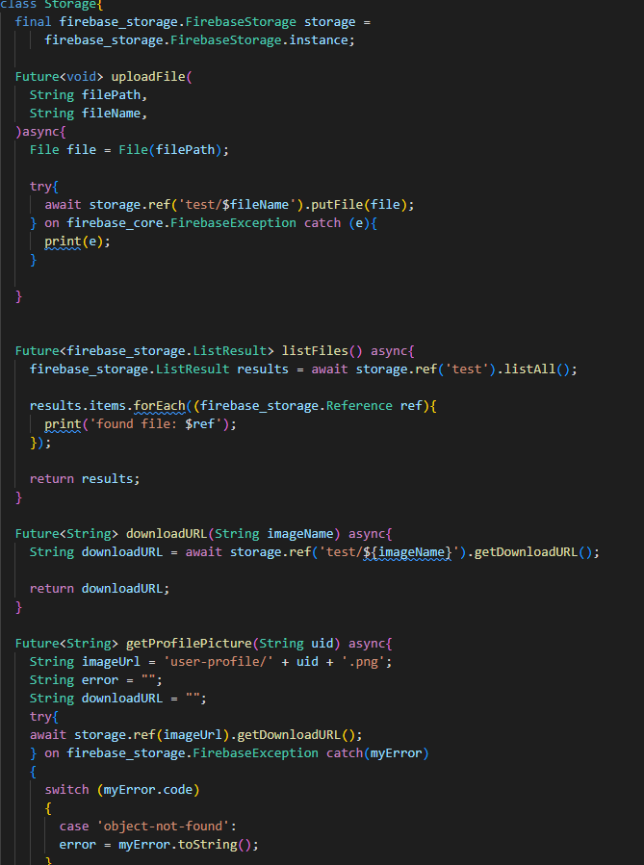
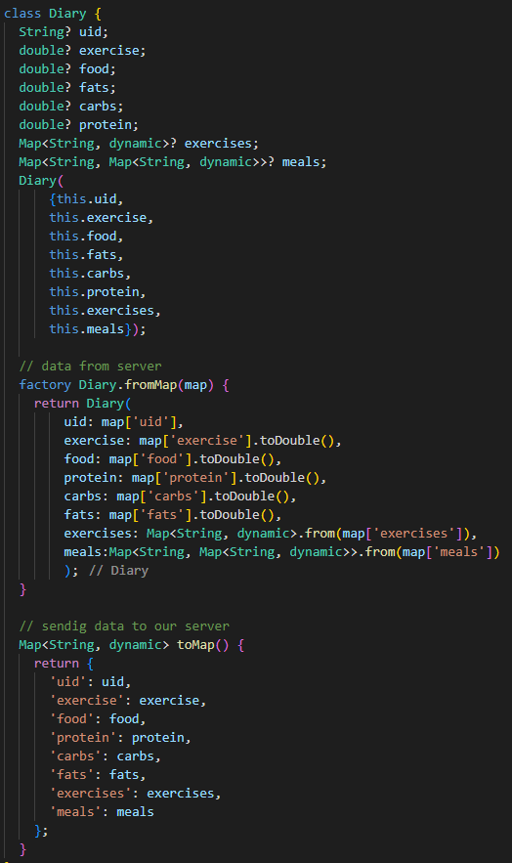
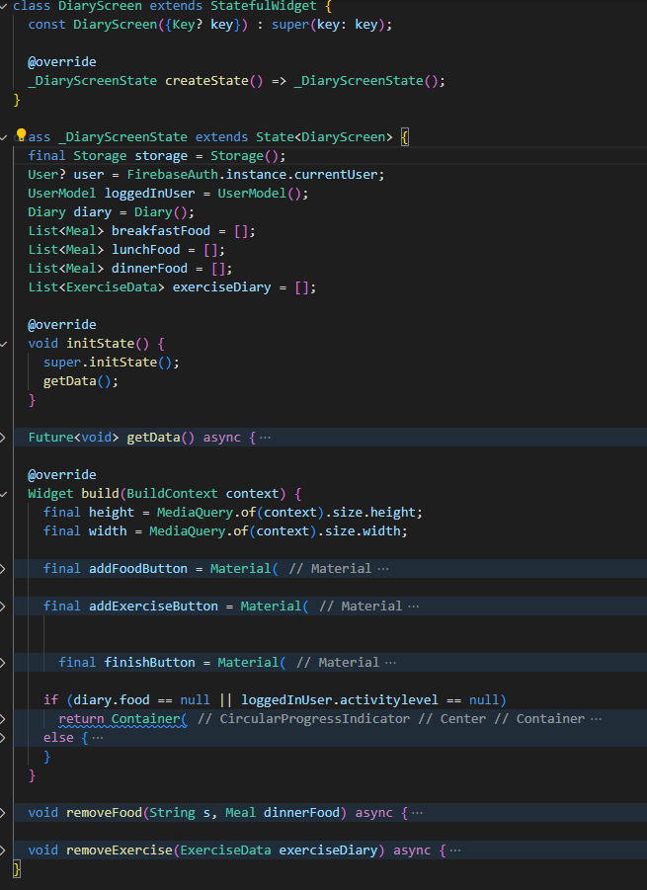
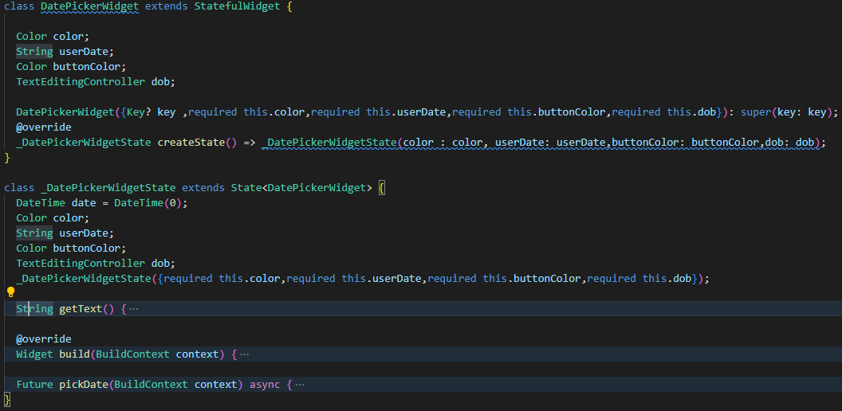

Slide 6

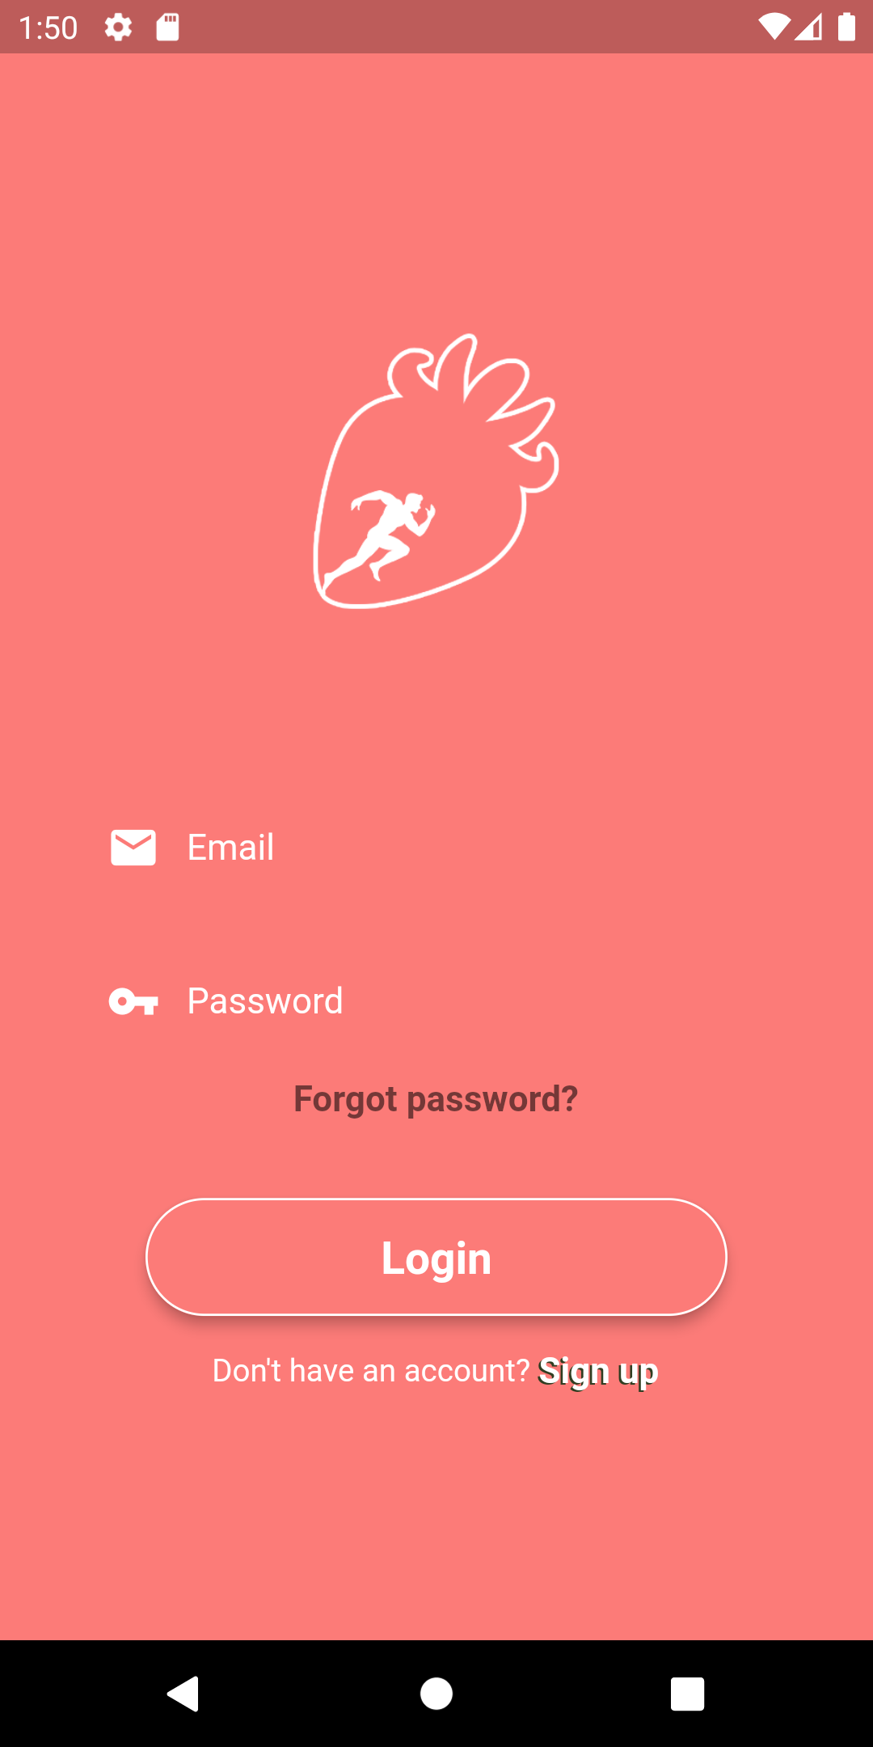
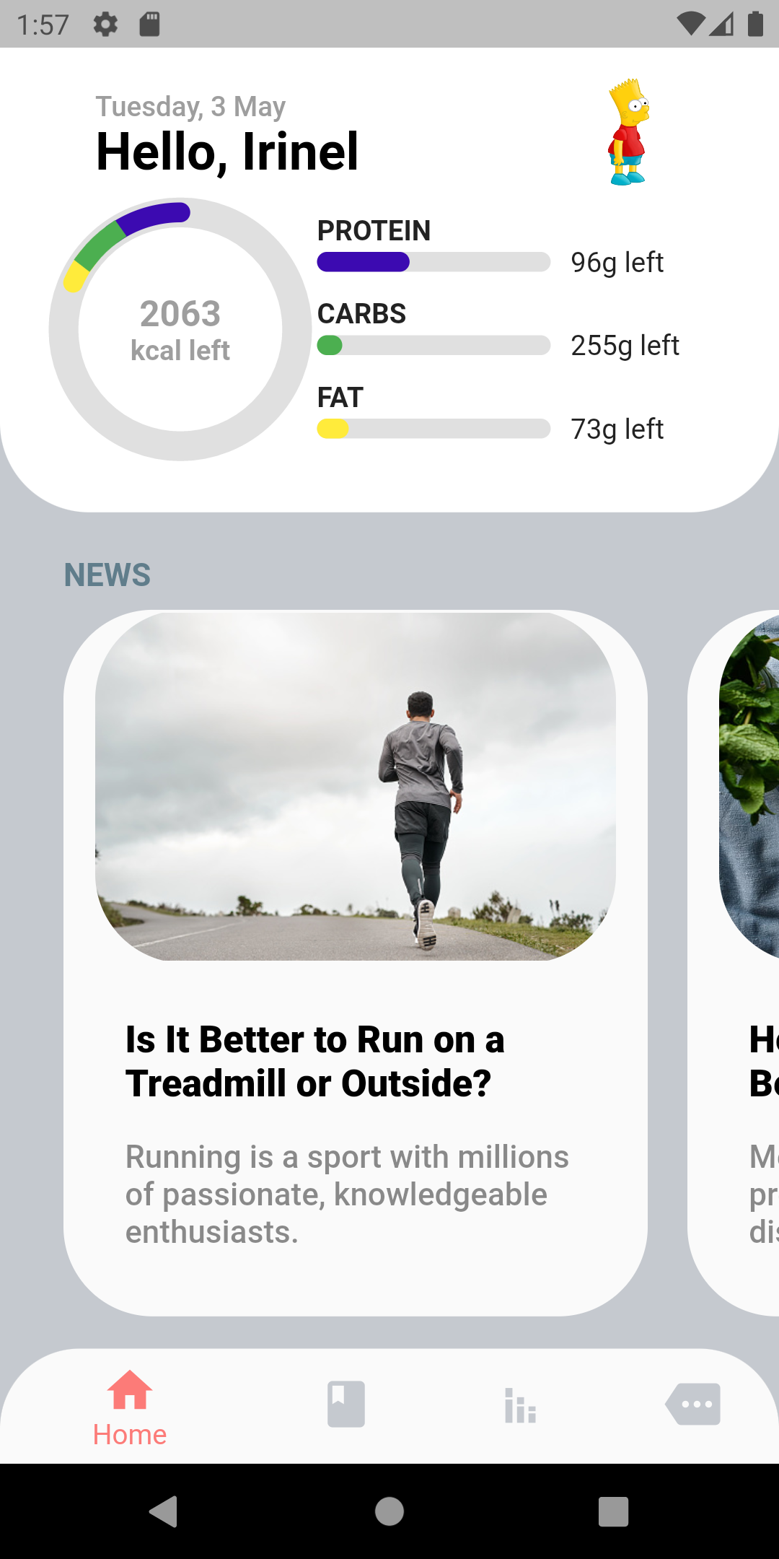
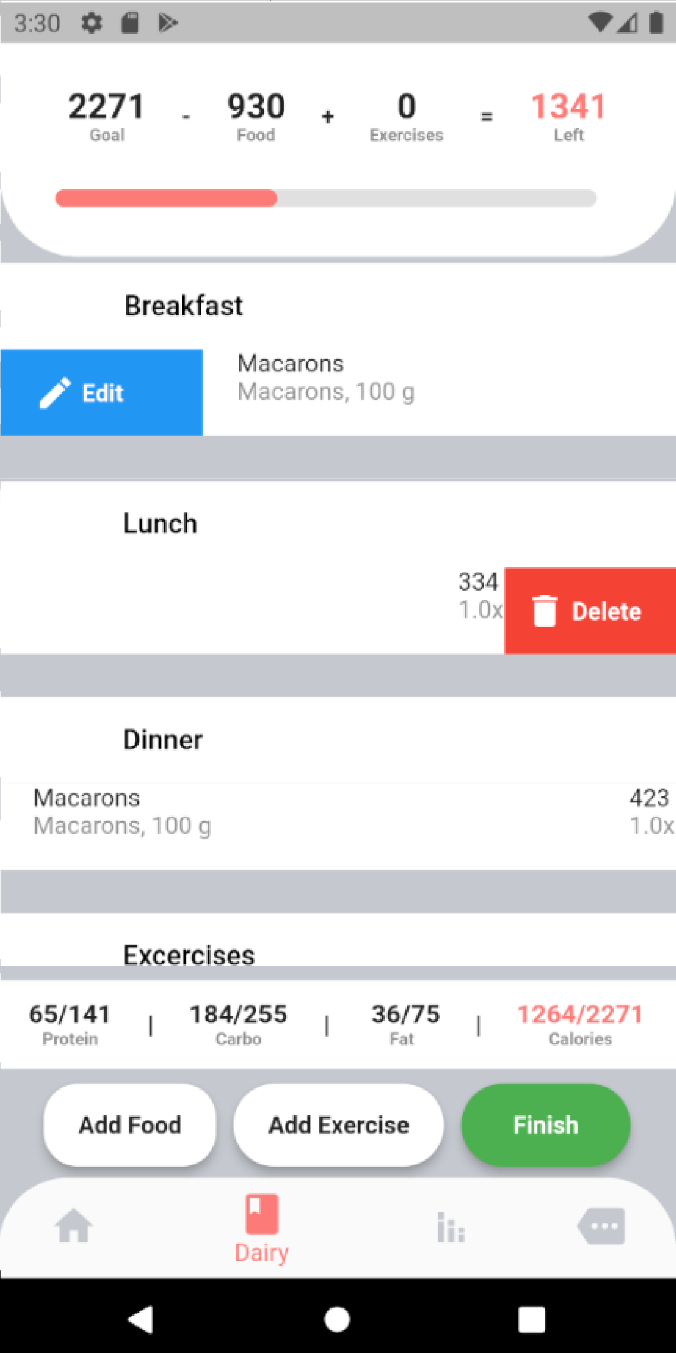
fiteat

Slide 7
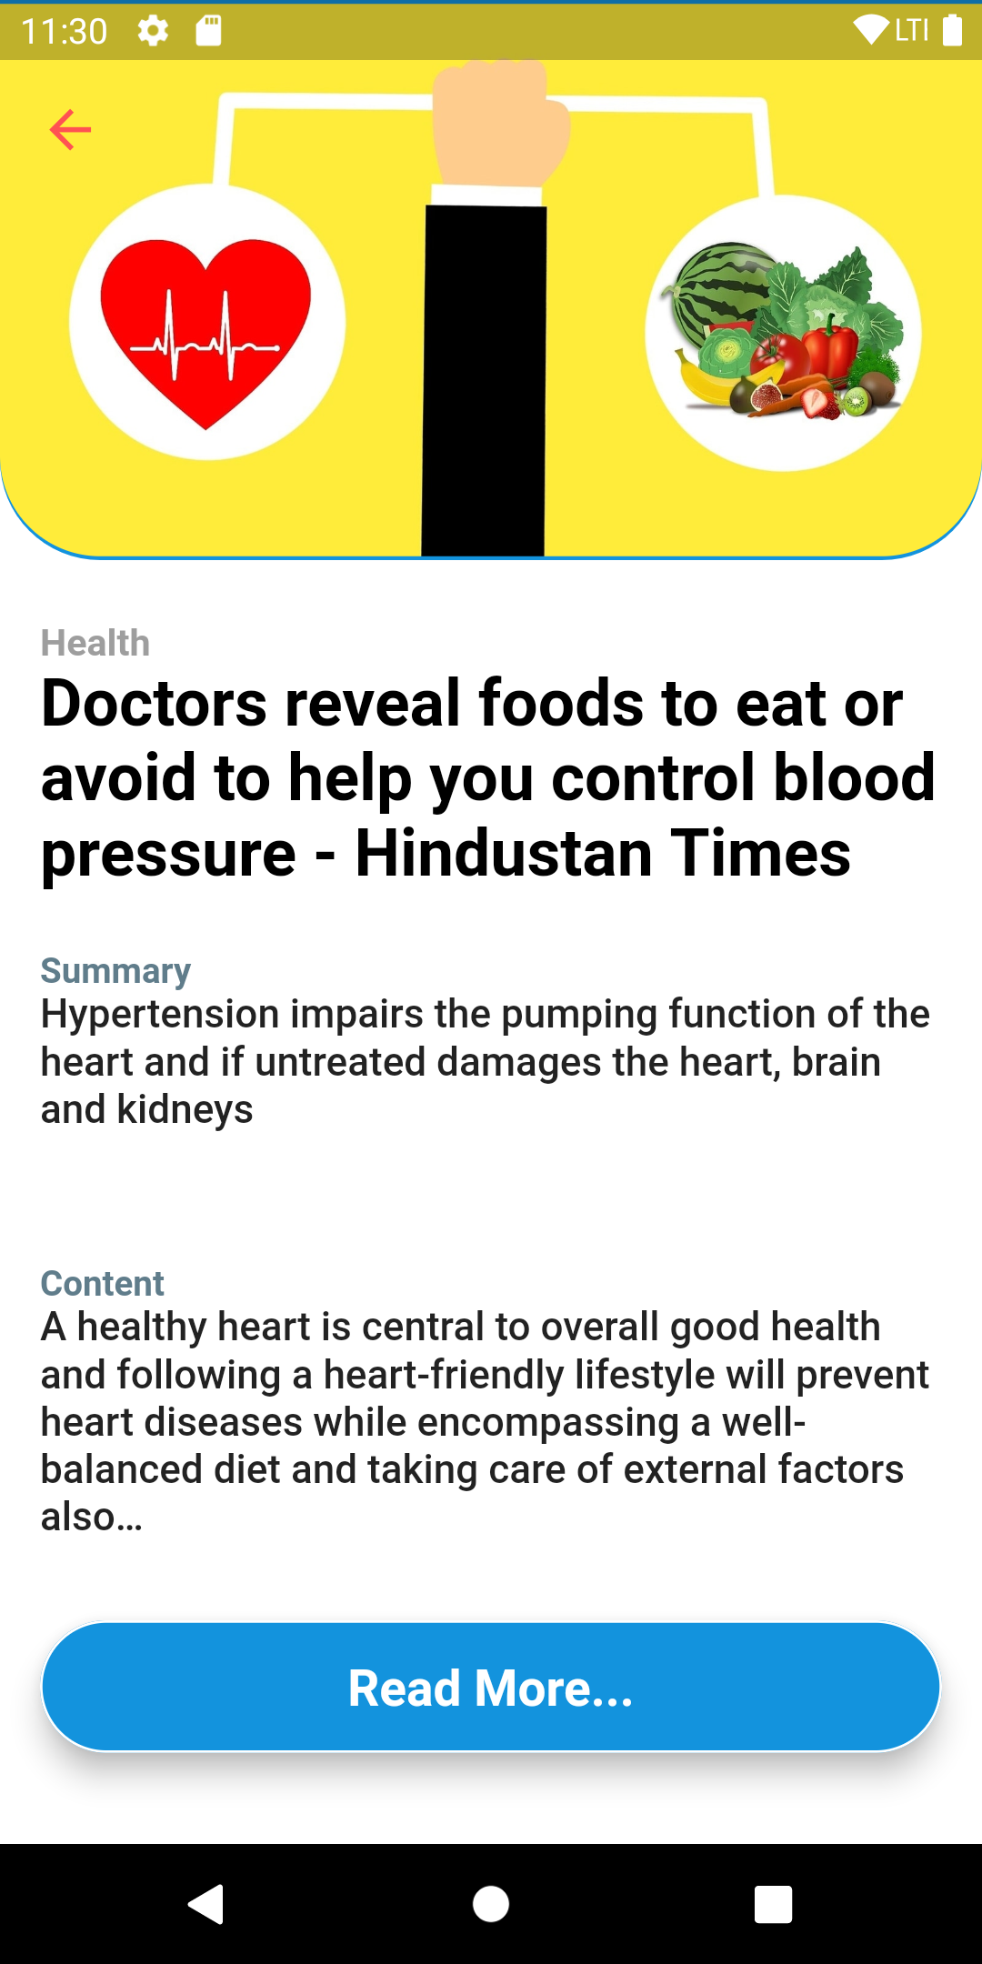
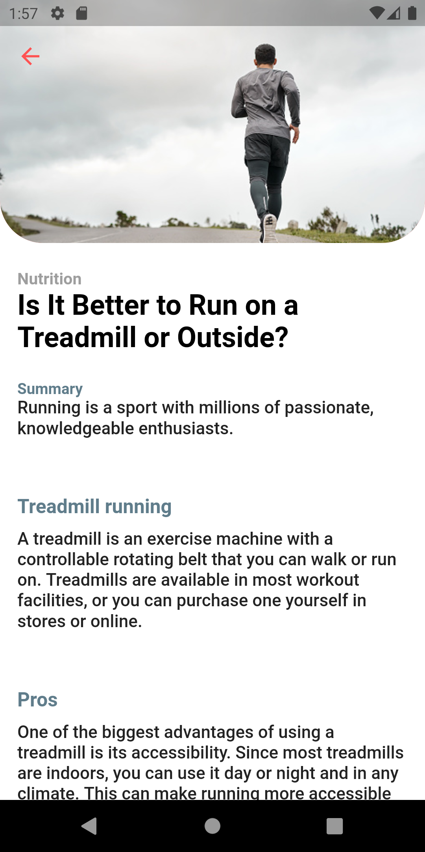
fiteat – News

Slide 8
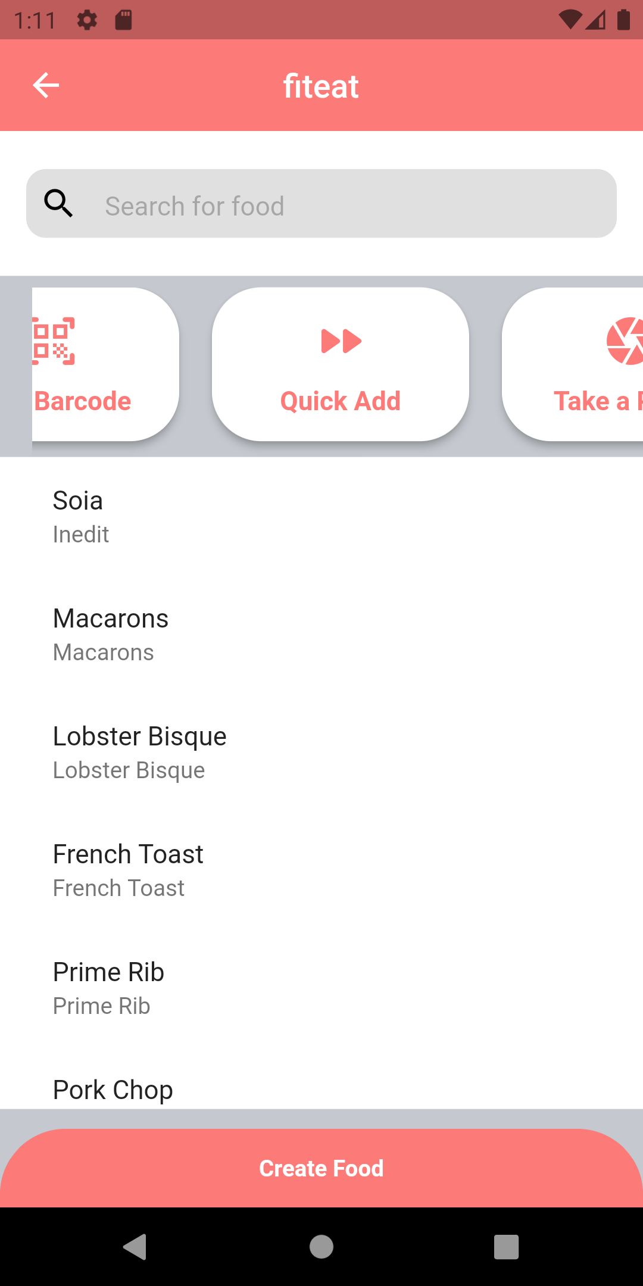
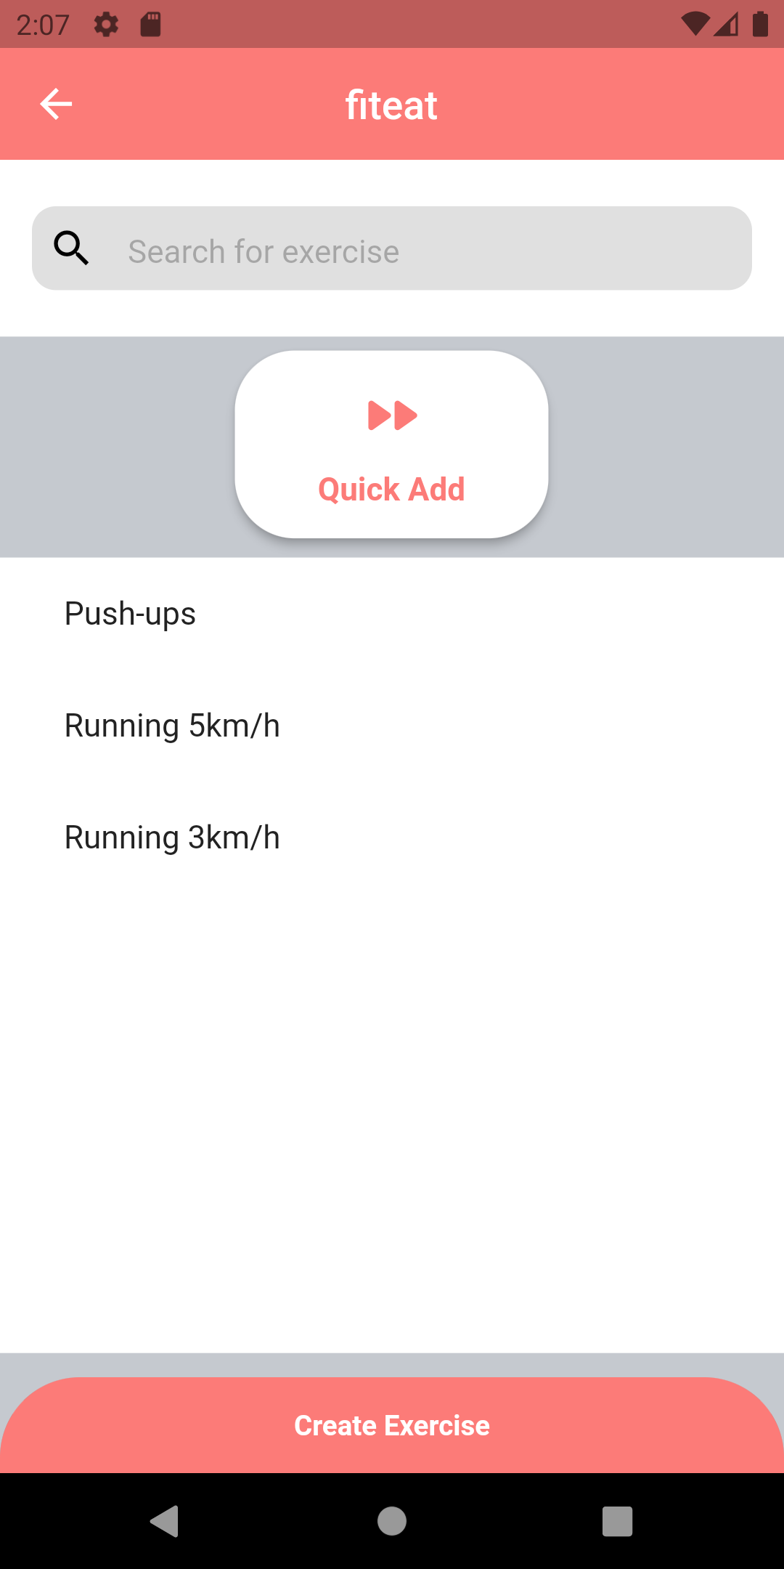
fiteat – Track food & exercise

Slide 9
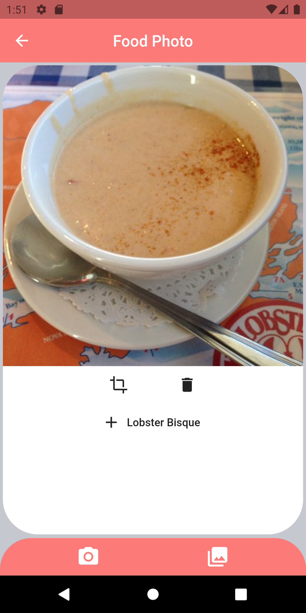
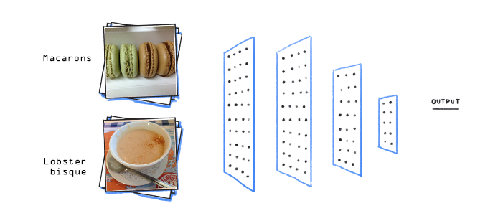
fiteat – Food Recognition

Slide 10
DEMO
fiteat

Slide 11
Multumesc pentru atentie!
fiteat

